Slide 1
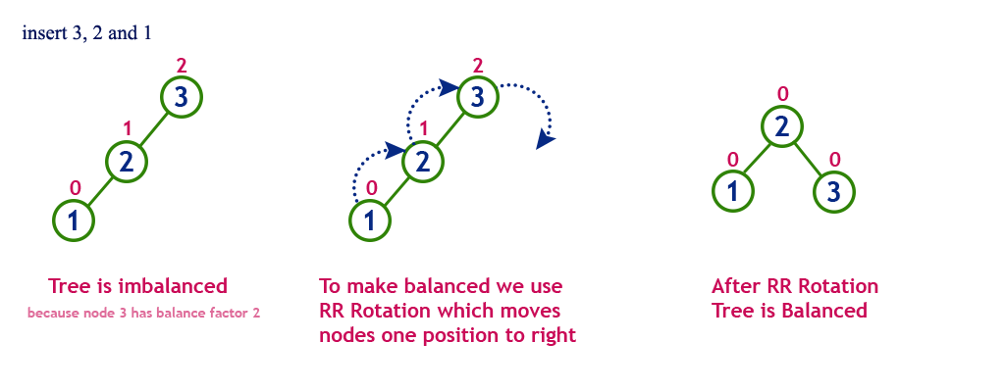
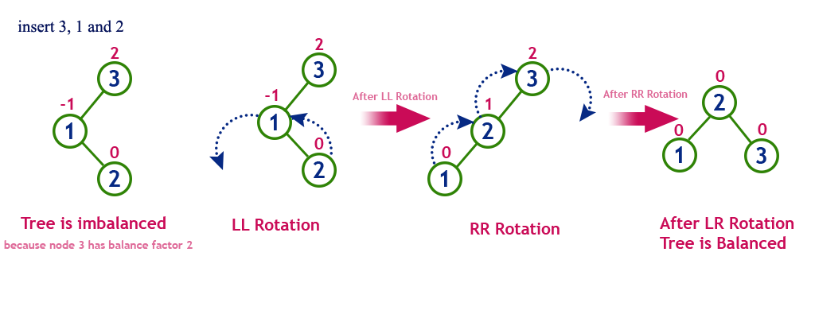
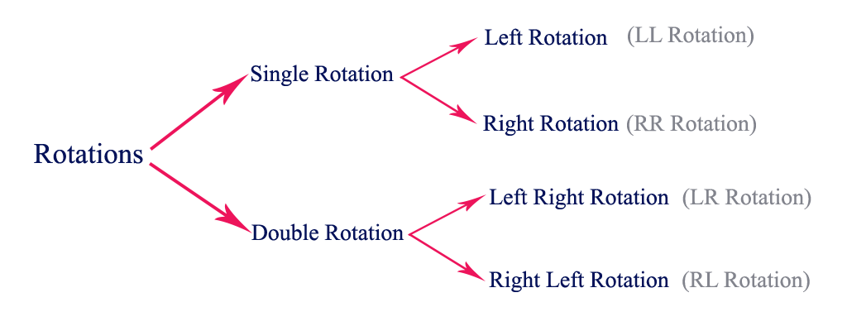
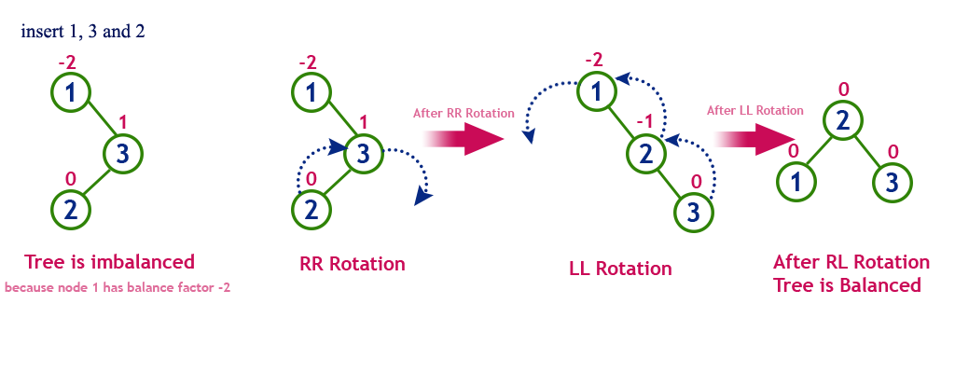
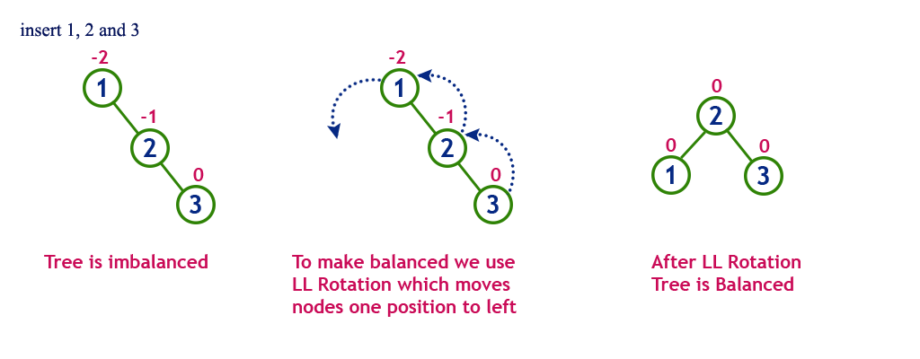

Slide 2
INSERT 1, 3 AND 2
-2
-2
-2
0
1
1
1
1
1
0
2
0
-1
0
3
0
3
2
0
1
3
2
2
3
Tree is imbalanced
First step is to perform a
RR Rotation.
Next step is to perform a
LL Rotation.
After RL Rotation, tree is balanced.
Because node 1 has balance factor -2.

Slide 3
INSERT 3, 1 AND 2
2
2
2
0
-1
3
3
3
0
2
0
-1
1
1
0
1
2
1
3
0
0
2
2
1
Tree is imbalanced
First step is to perform a
LL Rotation.
Next step is to perform a
RR Rotation.
After LR Rotation, tree is balanced.
Because node 3 has balance factor 2.

Slide 4
INSERT 1, 2 AND 3
-2
-2
0
1
1
0
2
0
-1
-1
2
2
1
3
0
0
3
3
Tree is imbalanced
To make it balanced, we use LL rotation which moves nodes one position to left.
After LL Rotation, tree is balanced.
Because node 1 has balance factor -2.
2
1
3
0
2
1

Slide 5
INSERT 3, 2 AND 1
2
2
0
1
3
1
3
0
2
0
2
2
1
3
0
0
1
1
Tree is imbalanced
To make it balanced, we use RR rotation which moves nodes one position to right.
After RR Rotation, tree is balanced.
Because node 3 has balance factor 2.

Slide 6
ROTATIONS
Single Rotations
Double Rotations
Left Rotation (LL)
Right Rotation (RR)
Left Right Rotations (LR)
Right Left Rotations (RL)

